Slide 1
NLP

Slide 2
Introduction to NLP
First Order Logic

Slide 3
Semantics
What is the meaning of: (5+2)*(4+3)?
Parse tree
49
E
E
F
E
E
F
E
*
E
F
E
N
+
N
N
+
N
5
2
4
3
Notes:
This slide and the next two slides are from 361

Slide 4
Semantics
What if we had (5+2)*(4+z)?
mult(add(5,2),add(4,z))
E
E
F
E
E
F
E
*
E
F
E
N
+
N
N
+
N
5
2
4
z

Slide 5
What about (English) sentences?
Every human is mortal.
??

Slide 6
Representing Meaning
Goal
Capturing the meaning of linguistic utterances using formal notation
Linguistic meaning
“It is 8 pm”
Pragmatic meaning
“It is time to leave”
Semantic analysis:
Assign each word a meaning
Combine the meanings of words into sentences
I bought a book: ∃ x,y: Buying(x) ^ Buyer(speaker,x) ^ BoughtItem(y,x) ^ Book(y)
Buying (Buyer=speaker, BoughtItem=book)

Slide 7
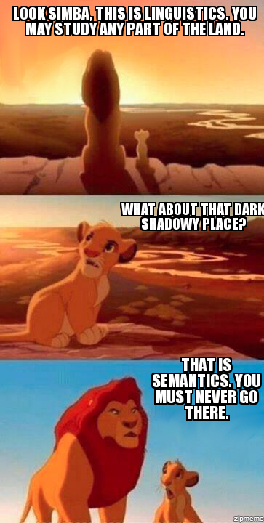

Slide 8
Properties of Propositional Logic
Pros
Compositional
Declarative
Cons
Limited expressive power
Represents facts

Slide 9
First Order Logic
Used to represent
Objects – Martin the cat
Relations – Martin and Moses are brothers
Functions – Martin’s age

Slide 10
First Order Logic
Formula → AtomicFormula | Formula Connective Formula
| Quantifier Variable Formula | ¬ Formula | (Formula)
AtomicFormula → Predicate (Term…)
Term → Function (Term…) | Constant | Variable
Connective → ∧ | ⋁ | ⇒
Quantifier → ∀ | ∃
Constant → M | Martin
Variable → x | y | …
Predicate → Likes | Eats | …
Function → AgeOf | ColorOf | …

Slide 11
Common Mistake (1)
⇒ is the main connective with ∀
Common mistake: using ∧ as the main connective with ∀:
∀x Cat(x) ∧ EatsFish(x)
means “Everyone is a cat and everyone eats fish”

Slide 12
Common Mistake (2)
∧ is the main connective with ∃
Common mistake: using ⇒ as the main connective with ∃:
∃x Cat(x) ⇒ EatsFish(x)
is true if there is anyone who is not a cat!

Slide 13
First Order Logic
NACLO problem from 2014
Author: Ben King
http://www.nacloweb.org/resources/problems/2014/N2014-H.pdf
http://www.nacloweb.org/resources/problems/2014/N2014-HS.pdf

Slide 14
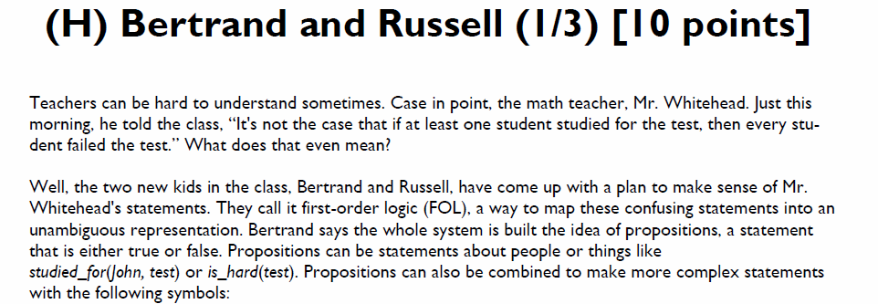
First Order Logic

Slide 15
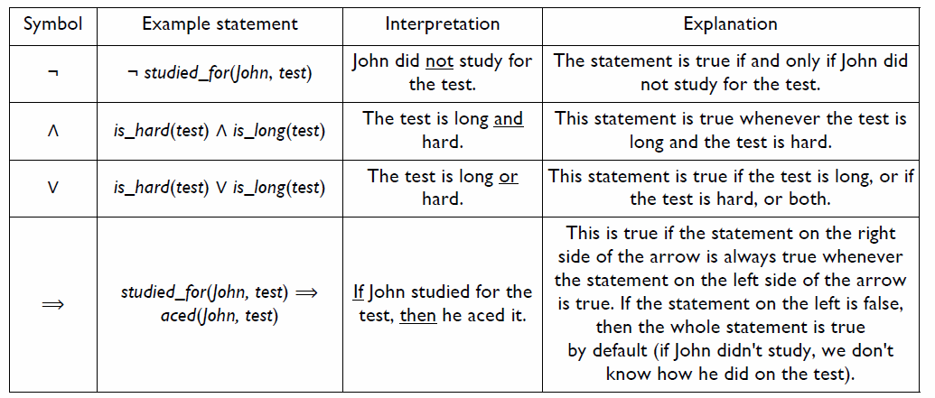

Slide 16
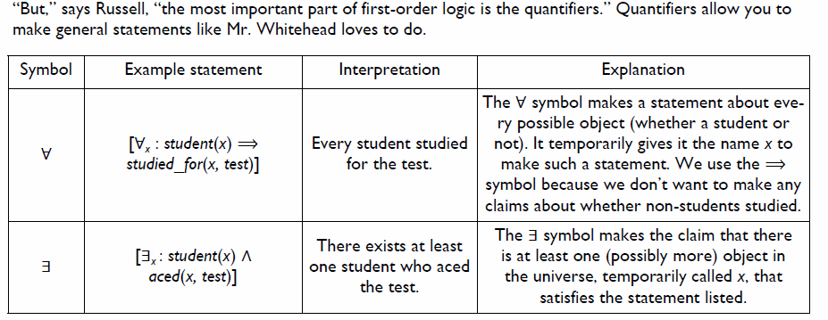

Slide 17
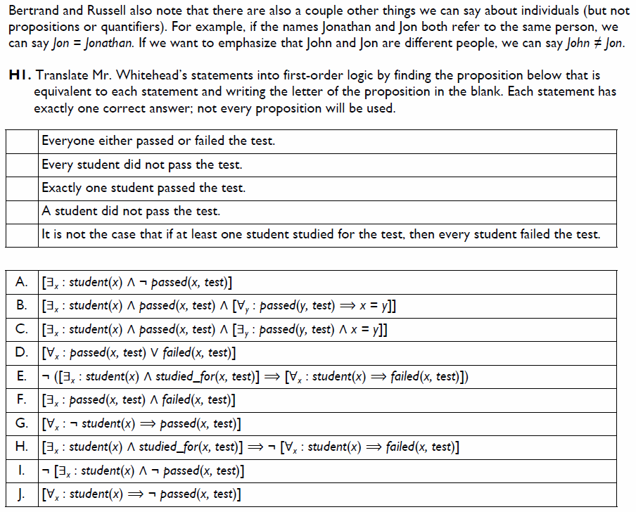

Slide 18
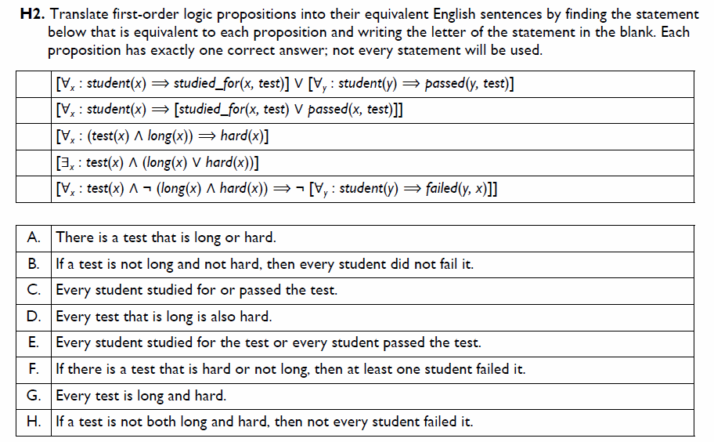

Slide 19

Solutions

Slide 20
Types
Base types
e (entity) – objects
t (truth values)
Complex types
If a is a type and b is a type, then a→b is a type.
(a→b)(a)=b
Example
Type of Mary = e
Type of sleeps = e→t
Type of sleeps(Mary) = t
Type of ^ = t→t
Type of ^(sleeps(Mary)) = t
* ^(sleeps) - not well typed

Slide 21
Lambda Expressions
Example
inc(x) = λx x+1
then inc(4) = (λx x+1)(4) = 5
Example
add(x,y) = λx,λy(x+y)
then add(3,4) = (λx,λy(x+y))(3)(4)= (λy 3+y)(4) = 3+4 = 7
Useful for semantic parsing (see later)

Slide 22
Lambda Expressions
λx.like(x,Mary)
λx.like(Mary,x)
λx.(λy.like(x,y))
λP.P(Mary)
property is true of Mary

Slide 23
Lambda Expressions
[λx.sleeps(x)](Mary)=sleeps(Mary)
[λx.likes(Mary,x)](John)=likes(Mary,John)
[λx.likes(x,y)](Mary)=likes(Mary,Mary)

Slide 24
Example
Input
Javier likes pizza
Output
like(Javier, pizza)

Slide 25
Example
S -> NP VP {VP.Sem(NP.Sem)} t
VP -> V NP {V.Sem(NP.Sem)} <e,t>
NP -> N {N.Sem} e
V -> likes {λ x,y likes(x,y) <e,<e,t>>
N -> Javier {Javier} e
N -> pizza {pizza} e

Slide 26
Semantic Parsing (preview)
Associate a semantic expression with each node
S: likes(Javier, pizza)
N: Javier
VP: λx likes(x,pizza)
Javier
V: λ x,y likes(x,y)
N: pizza
likes
pizza

Slide 27
NLP

